Slide 1
Radiation Monitoring and Health Surveillance at the Service of Improving Living Conditions in Post-Accident Situations:
Some Lessons from Chernobyl
Jacques LOCHARD
Director of CEPN – France
Vice-chair of ICRP
15th International Congress of Radiation Research
Kyoto, Japan
27 May 2015

Slide 2
Background : the ETHOS project and CORE program in Belarus (1996-2008)
Pilot experiments supported by the Belarus authorities in 4 districts of Southern Belarus affected by the Chernobyl accident
Aiming at developing a sustainable improvement of the living conditions of the local population
Based on the direct involvement of the local population in its own protection
Addressing its key concerns : protection of children, radiological quality of foodstuffs (particularly milk and meat), management of the domestic radioactive waste, ….
Notes:
08/06/15
1

Slide 3
  The stakeholder involvement process implemented in the ETHOS project
Listening and learning from the villagers about their concerns, difficulties and wishes
Developing a shared evaluation of the local radiological situation between local experts and professionals and the inhabitants (co-expertise)
Implementing actions for improving the radiological situation and the living conditions of the villagers
Re-establishing links between villagers and the local authorities and professionals
Notes:
08/06/15
2

Slide 4
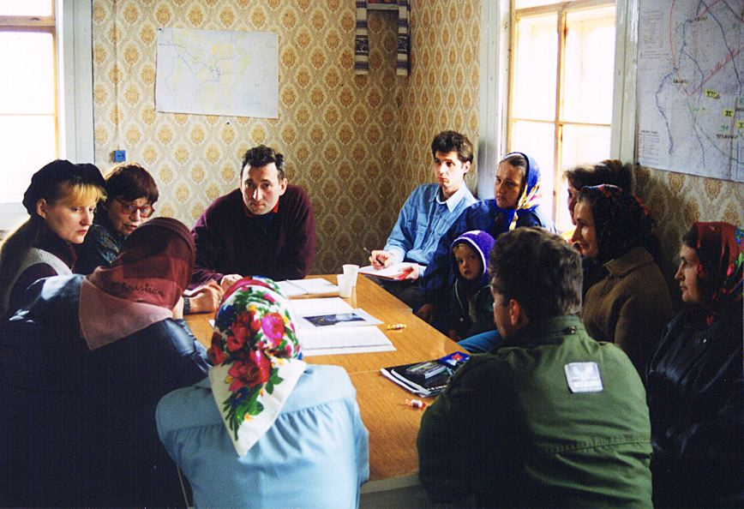
  Listening about concerns - Public Meetings

Slide 5
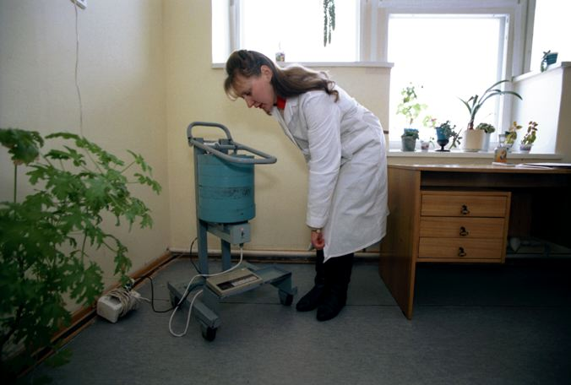
  Access to local expertise

Slide 6
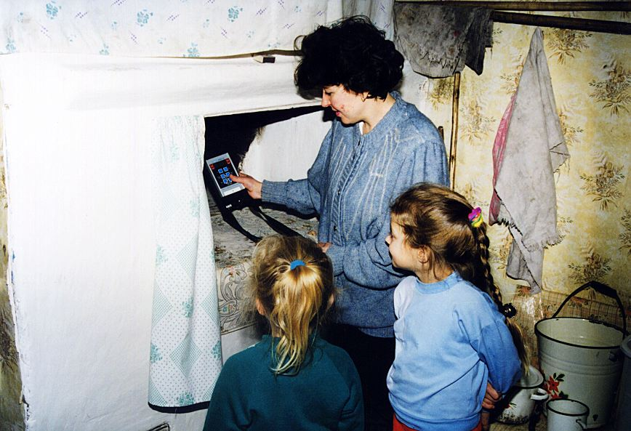
  Empowerment of villagers

Slide 7
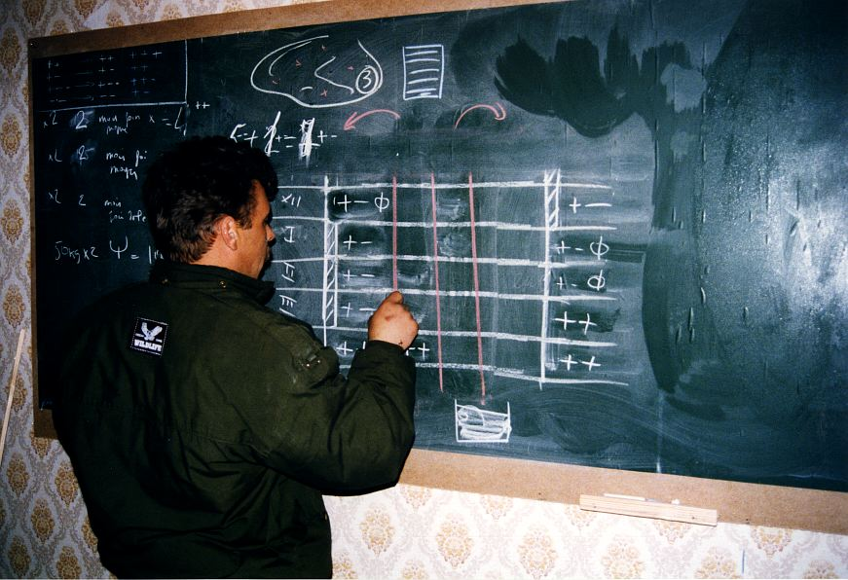
  Implementing protection actions
  (Optimization of winter milk production)

Slide 8
  The radiation monitoring project in the Bragin district (2004-2008)
Establishment of a radiation monitoring system including centres for the measurement of foodstuffs in 6 villages and the measurement of the whole-body contamination in the hospital
Aiming at providing access to the measurements for all the inhabitants
Allowing the population to be able to participate to its own protection and to regain self-control on its direct environment
Importance of the pluralism of sources of measurement for ensuring confidence and providing useful information to cope with the local situation
Notes:
08/06/15
7

Slide 9
  The radiation monitoring system implemented in the Bragin District
Families
Self-help protection actions
Schools
Transmission
Radiological quality control centres
Hospitals
Vigilence
Measurements of food products
Measurements of
persons
Local authorities
Collective protection actions

Slide 10
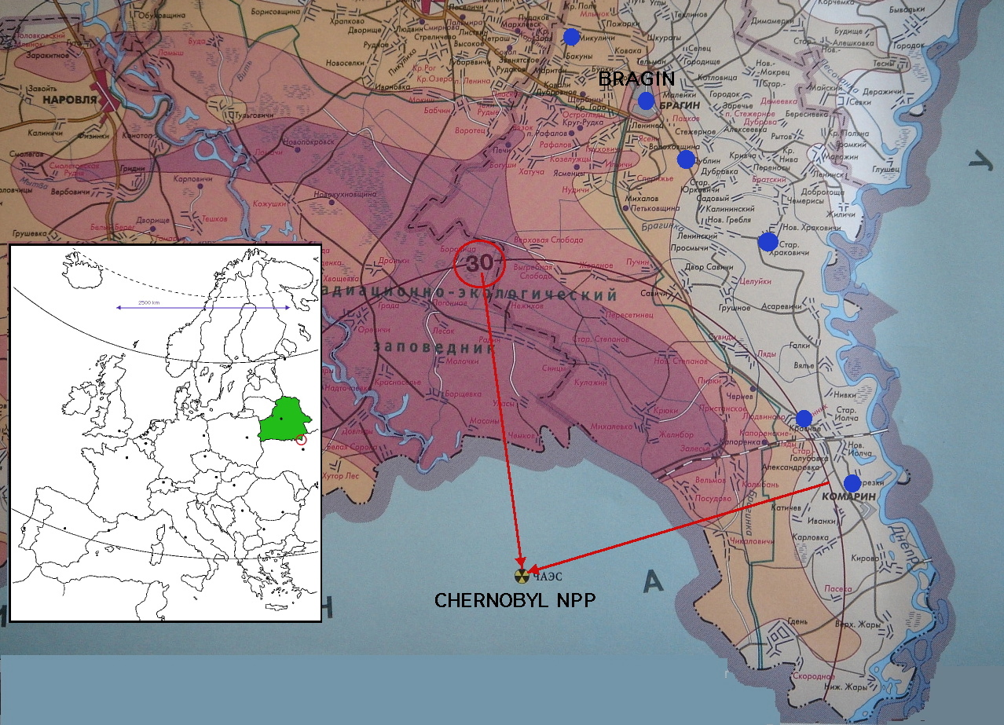
  The Bragin District
9

Slide 11
  The approach for reducing the whole body contamination
Identification of the most contaminated children through whole body measurement campaigns in schools
Dialogue with the concerned families to identify the main sources of contamination organized by a local NGO
Measurements of the foodstuffs consumed in the families
Identification of possible margins of manoeuvre to reduce the intake of contamination – actions of the local authorities if needed
Follow up of the evolution of the whole body contamination of the children by the following campaigns

Slide 12
  Radiological Quality Control Centre

Slide 13
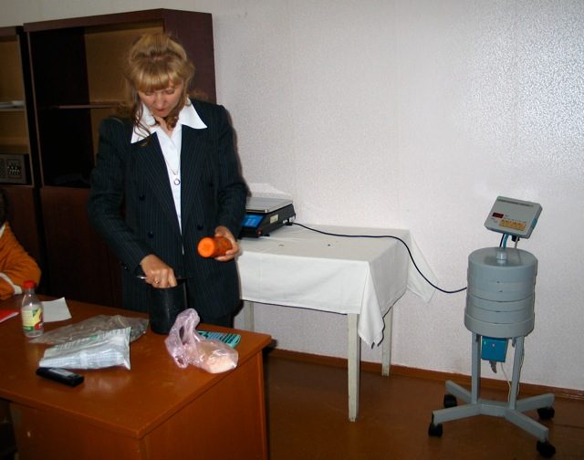
  Measurements of foodstuffs (1)

Slide 14
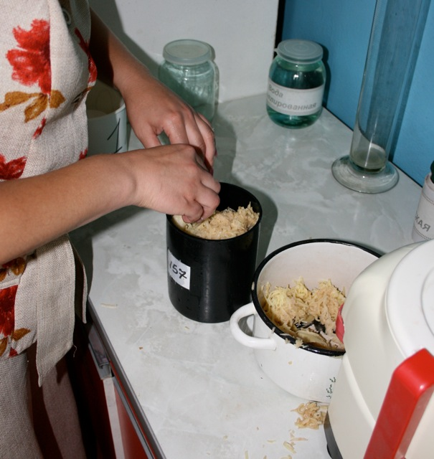
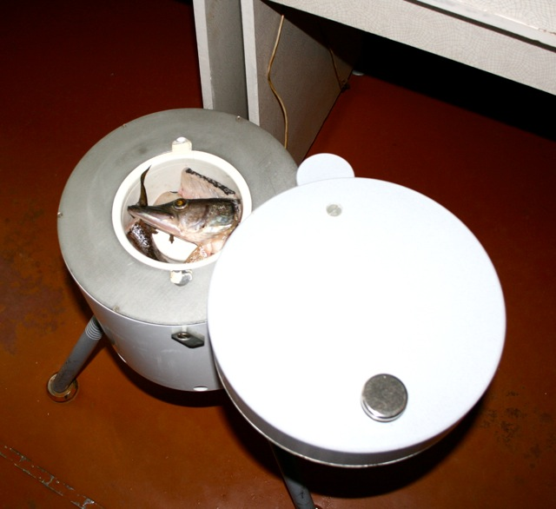
  Measurements of foodstuffs (2)

Slide 15
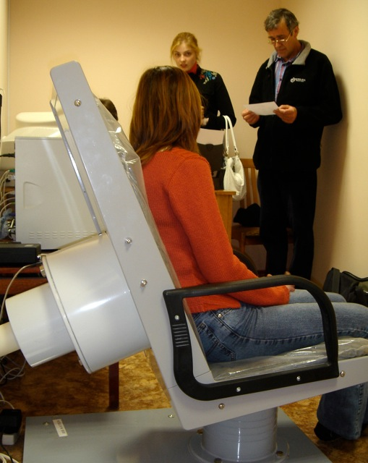
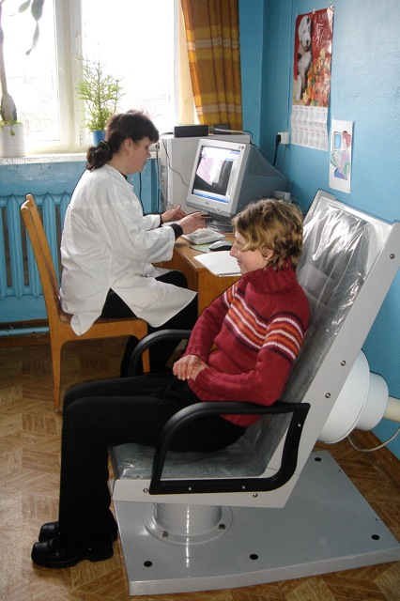
  Whole body measurements (1)

Slide 16
  Results of foodstuffs measurements
About 8000 measurements of all types of foodstuffs and products have been performed in the 6 villages during the Project
These measurements have revealed unexpected variations of the levels of contamination from one year to the other and also large discrepancies for certain foodstuffs like milk or mushrooms
Altogether the measurements have not shown a significant reduction of the levels of contamination during the 5 years of the Project

Slide 17
Whole body measurements
From April 2004, 2 whole body measurement campaigns per year were performed in the schools of the District
In total more than 17,000 measurements have been performed to follow the 2500 school children of the District
The number of children with a whole body contamination higher than 100 Bq/kg of weight was significantly reduced from more than 60 at the beginning of the project to less than 10 by the end of 2008.
The maximum level of whole body contamination was divided by about 10 and the average individual dose by about 2

Slide 18
Results of the whole body measurement campaigns
 | Number of measures | Mean value (Bq/kg) | Maximum value (Bq/kg) | Number of measurements > 50 Bq/kg | Number of maesures > 100 Bq/kg
Autumn 04 | 2592 | ~ 32 | 2660 | 249 | 64
Spring 05 | 2526 | ~ 29 | ➢➢260 | ➢134 | ➢18
Autumn 05 | 2612 | ~ 24 | ➢190 | ➢109 | ➢12
Spring 06 | 2530 | ~ 25 | ➢168 | ➢50 | ➢4
Autumn 06 | 2486 | ~ 31 |  980 |   242 |   43
Spring 07 | 2438 | ~ 23 | ➢➢ 247 | ➢➢ 32 | ➢➢ 3
Autumn 07 | 1705 | ~ 14 | ➢ 235 |  86 |  7

Slide 19
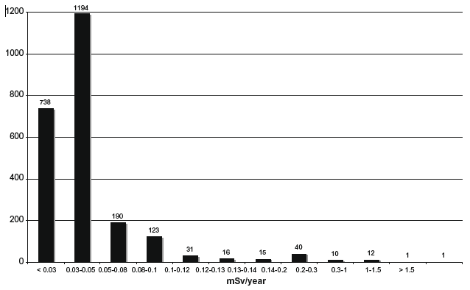
Typical dose distribution from caesium intake of children in the contaminated area around Chernobyl
20 years after the accident
Reference level: 1 mSv

Slide 20
Lessons from the Bragin project
      When people understand :
        where, when and how they are exposed?
        and what can they do to protect themselves ?
        they spontaneously engage themselves in their own protection and they progressively take control of the situation they face every day (self-help protection)
      This engagement is made possible through a co-expertise process involving the affected population, the institutional experts, the local authorities and the professional community workers particularly medical professionals and teachers

Slide 21
The health surveillance project in the Chechersk district
    To improve the health of children in the Chechersk district through an integrated and inclusive approach involving the local health professionals and teachers as well as parents
    Combining:
        Radiation monitoring : giving direct access to the families to the measurements of foodstuffs and the whole body contamination in order to develop radiation protection culture (Similar to the Bragin Project)
        Health surveillance: performing thorough health check-ups of the children :
            to identify pathologies and treat them as needed
            to inform the population about the health situation
            to set up priorities for the health care system
            to contribute to identify risk factors

Slide 22
The articulation between the follow up of health and
the development of radiological protection culture
Families
Day-to-day management (Self-help protection actions)
Measurements (environment, foodstuff): Understanding the situation; Development of the RP culture at the family level
Dialogue, Advice (always)
Care (if needed)
Health professionals
and
radiation protection experts
Local centres for practical RP culture
(in primary schools)
Health survey +
WBC Measurements
Information of inhabitants;
Development of the RP culture and vigilance at the local level
Health data collection and analysis; Adaptation of the health care and screening programme and identification of socio-economical needs
Local/Regional Authorities
Longer term and collective recovery management
*St-Vincent de Paul

Slide 23
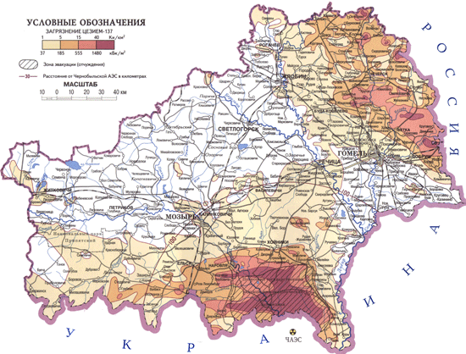
The Chechersk district
.
.Chechersk
.
.
250 km
^{Gomel}
Bragin
CHERNOBYL
Notes:
Le district de Tchetchersk est situé au sud-est de la Biélorussie (région i.e. « oblast » de Gomel), à approximativement 200 kilomètres de la centrale de Tchernobyl. Il est l’un des districts les plus fortement contaminés par les retombées (dépôts humides) de l’accident de Tchernobyl. Fin 2008, l’ensemble du district (123 000 hectares) présente encore des niveaux de contamination surfacique en césium 137 supérieurs à 37 000 Bq.m⁻² (1 Ci.km⁻²) (cf. Figure 3).
Le district de Tchetchersk compte 7 soviets : Tchetchersk, Merkoulavitchi, Nisimkavitchi, Ottor (ou Lenisky-Kamounaleminsk), Polessié, Rovkhavitchi et Zalessié. D’après les acteurs locaux, les soviets les plus contaminés sont ceux de Polessié et de Rovkhavitchi. Le village de Polessié est particulièrement isolé du reste du district de Tchetchersk, en bordure de forêt.
Près de 115 000 hectares du district sont contaminés dont 68 000 hectares de forêts et 34 000 hectares de terres cultivables (12 000 hectares ont été définitivement condamnés comme impropres à la culture en raison des niveaux de contamination trop élevés). 2 418 villageois ont été évacués et relogés (32 villages), 5 239 personnes ont quitté Tchetchersk, 4 villages ont été enterrés. En janvier 2009, la population du district de Tchetchersk était de 16 000 habitants, une petite moitié dans la ville de Tchetchersk.
Au cours des premières années qui ont suivi la catastrophe de Tchernobyl, la situation démographique du district a été bouleversée. Une très forte émigration a fait chuter la population totale du district de 46% (et la population rurale s’est réduite de près de 60%) ! On a constaté aussi un fort vieillissement de la population, les personnes les plus âgées étant restées sur place alors que les actifs sont allés chercher du travail à Gomel ou ailleurs, en dehors du district (en 2008, le district comptait 693 retraités pour 1000 actifs). Ces changements de la structure de la population ont notamment entraîné les fermetures de nombreuses écoles et collèges, bibliothèques et autres « clubs (équivalents en France aux associations à l’échelle communale).

Slide 24
The health check-ups of children (1)
    Follow-up of 2500 children from 3 to 15 years (more than 90% of the number of children of the district)
    About 80 indicators concerning the living conditions and the health status collected 3 times between 2005 and 2009
    3 measurements of the whole body contamination
    Children with pathologies identified during the check-ups have received treatments immediately
    They also received, as well as their families, information on the way to manage/improve their radiological situation by involving themselves in the radiation monitoring of their environment and their diet

Slide 25
The health check-ups of children (2)
    The protocol of the health check-up has been elaborated in partnership between Belarusian and French paediatricians
    Meetings with local stakeholders (teachers, medical doctors, families, local authorities …) have been organized to identify their expectations concerning the check-ups and also the way they wanted to be informed about the results
    Data collected during the check-ups have been presented and discussed with parents and also have helped the health professionals to adapt the treatments of diagnosed diseases
    The project also included an equipment supply component to perform the exams, as well as a training component for the practicing physicians

Slide 26
Distribution of 137Cs body burden in children (%)
Bq/kg | 2005 | 2007 | 2009 %
< 10 | 47,5 | 43,6 | 69,8
10 – 20 | 23,3 | 23,8 | 14,7
20 – 50 | 19,7 | 21,5 | 10,8
50 - 100 | 7,6 | 8,2 | 3,5
> 100 | 1,9 | 2,9 | 1,2
Average (Bq/kg) | 21 | 42 | 12
Maximum (Bq/kg) | 834 | 19326 | 566

Slide 27
The health situation of children
    Health indicators focused on the psychomotor development, anaemia, the gastrointestinal, thyroid and cardiac dysfunctions
    The data show that living conditions and, to a lesser extent, the area of residence (rural/urban) are the major determinants for child development
    No thyroid cancer was diagnosed, which could be expected since all children were born many years after the accident
    Cardiac and gastro-intestinal dysfunctions are more frequent in urban than in rural area and for children with good living conditions but without any correlation with ¹³⁷Cs density deposition or body burden.
    There is no correlation between the development or the health indicators considered and the radioactive density deposition or the level of internal contamination

Slide 28
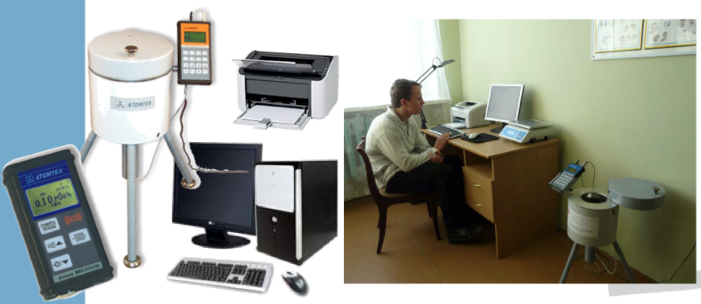
The local centres for the development of
practical radiological protection culture

Slide 29
Lessons from the Chechersk project
    The Chechersk project has identified the importance to integrate the long term contamination issue in a global preventive approach including information and education on the health of the population and particularly of children
    Beyond the need to provide the population with an objective information on its health status there is also the need to develop an interactive approach involving all concerned actors to elaborate, interpret and present this information
    The project has revealed the importance of training the health professionals to radiation protection and dialogue techniques to re-enforce their role in the management of the radiological situation

Slide 30
Concluding remarks (1)
    Projects implemented in Belarus in the late 1990s and the 2000s have demonstrated that the direct engagement of the population (who wish to stay in the affected areas) in radiation monitoring and health surveillance of the situation is feasible and also effective to break the vicious circle of loss of control and exclusion
    This involvement must rely on the dissemination within all segments of the population of a “practical radiation protection culture” based on 2 key pillars:
      A radiation monitoring system giving direct access to individuals to the radiological quality of their environment and diet and their exposure
      A health surveillance system involving the population and responding to its concerns

Slide 31
Concluding remarks (2)
      Places of dialogue to listen to the concerns of people and to exchange experiences are essential to initiate the process, which progressively lead to the development of the practical radiological protection culture among the people
      In this process the role of experts is to serve local actors and to facilitate the development of their ability to assess and manage their own situation (Self-help protection). Experts must shift from the explanation of phenomena to the resolution of problems together with the affected people
      National and local resources must be mobilized to support the process and the community projects aiming to improve the living conditions of the people

